Slide 1

Problem Statement
A customer support department needs to communicate to customers when a significant event occurs.
Customers need to be notified using either email or voicemail in the customer’s preferred language.
Notes:
The problem statement is that the customer support department needs to communicate to customers when a significant event occurs. This could be a change in their subscription, a new service, or outage of a service. The communication needs to be in the customer’s preferred language, and they should be notified via email or voicemail.

Slide 2

Solution Overview
AWS services – AWS Lambda, Polly, Translate, S3 bucket, SES to develop a solution
Translate can convert text to other languages
Polly can convert the text to voice and generate an MP3 file in S3
SES – simple email service can send email
Lambda can be used to orchestrate these services
Notes:
The solution is to use AWS services to develop a solution. Translate can convert text to other languages, Polly can convert the text to voice and generate an MP3 file in S3, and Lambda can be used to orchestrate these services.

Slide 3

AWS Services Overview
Notes:
Amazon Web Services (AWS) is a cloud computing platform that provides a wide range of services for various use cases. Amazon Polly, Translate, and Lambda are services provided by AWS that can be used to develop a solution that can notify customers using either email or voicemail in the customer’s preferred language.

Slide 4

AWS Lambda
AWS Lambda is a serverless compute service
It is used to run your code in response to events
Lambda automatically scales applications in response to incoming requests
It supports languages like Java, Python, Node.js, C#
Notes:
AWS Lambda is a powerful serverless compute service that allows you to run your own code in response to events. It can automatically scale your application in response to incoming requests, and supports a wide range of programming languages. Images related to serverless computing or code execution can be used to represent the service.

Slide 5

AWS Polly
AWS Polly is a text-to-speech service
It converts written text into natural sounding speech
You can use Polly to create voice interfaces for applications
It supports multiple languages, and you can customize speech output
Notes:
AWS Polly is a powerful text-to-speech service that allows you to convert written text into natural sounding speech. It's commonly used to develop voice interfaces for applications, and supports multiple languages. Images related to speech or voice assistants can be used to represent the service.

Slide 6
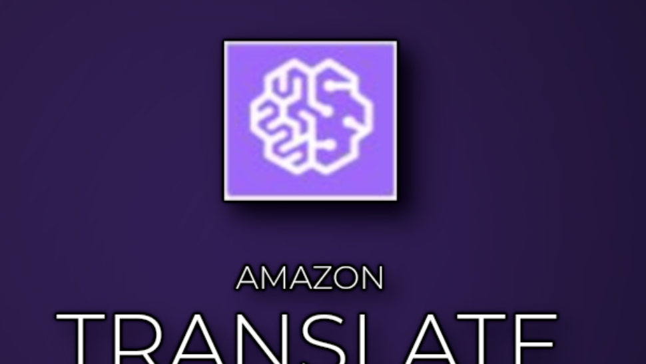
AWS Translate
AWS Translate is a machine translation service
It supports multiple languages
It can be used to translate text in real-time
You can use it to create multilingual applications
Notes:
AWS Translate is a powerful machine translation service that allows you to translate text in real-time. It can be used to create multilingual applications and supports a wide range of languages. Images related to translation or multilingualism can be used to represent the service.

Slide 7

AWS S3 Bucket
AWS S3 is a highly scalable object storage service
It allows you to store and retrieve files, images, videos, and data
You can use it to host static websites and for backup and archiving
S3 can be integrated with other AWS services such as Lambda, EC2 and RDS
Notes:
AWS S3 is a widely used, highly scalable object storage service that allows you to store and retrieve files, images, videos, and data. It has a range of use cases, including hosting static websites, backup and archiving, and integrating with other AWS services such as Lambda, EC2 and RDS. Images related to file storage or data centers can be used to represent the service.

Slide 8

AWS Simple Email Service
AWS SES is a cloud-based email sending service
It allows you to send and receive emails using your own email addresses
SES can be used to send transactional emails, marketing emails or any other type of messages
SES is scalable, reliable and cost-effective
Notes:
AWS SES is a powerful cloud-based email sending service that allows you to send and receive emails using your own email addresses. It's often used to send transactional emails, marketing emails or any other type of messages. SES is scalable, reliable and cost-effective. Images related to email or envelopes can be used to represent the service.

Slide 9

Lab Exercise
Lab Actions Highlight -
Set up AWS services: Polly, Translate, and Lambda
Create the Lambda function that will invoke Translate and Polly
Use Polly to convert the translated text to voice and generate an MP3 file in S3
Generate a pre-signed URL to the MP3 file and email it to the customer
Lab guide is posted here in Github Repo
awslabproject/Labguide.md at main · zobayer098/awslabproject (github.com)
Notes:
In this lab exercise, you will learn how to set up AWS services: Polly, Translate, and Lambda. You will also learn how to create the Lambda function that will invoke Translate and Polly. Finally, you will learn how to use Polly to convert the translated text to voice and generate an MP3 file in S3. Then, you will generate a pre-signed URL to the MP3 file and email it to the customer.

Slide 10

Lab Exercise Outline
Lab guide is posted here in Github Repo
awslabproject/Labguide.md at main · zobayer098/awslabproject (github.com)
Notes:
The lab exercise involves four main steps: Setting up AWS services: Polly, Translate, and Lambda. Creating the Lambda function that will invoke Translate and Polly. Using Polly to convert the translated text to voice and generate an MP3 file in S3. Generating a pre-signed URL to the MP3 file and emailing it to the customer.

Slide 11

Demo
Notes:
In this demo, we will show you a recorded video on how to set up the AWS services, create the Lambda function, use Polly to convert the translated text to voice and generate an MP3 file in S3, and generate a pre-signed URL to the MP3 file and email it to the customer.

Slide 12

Conclusion and Q&A
Notes:
In conclusion, the AWS services can be used to develop a solution that can notify customers using either email or voicemail in the customer’s preferred language. The lab exercise teaches you how to set up these AWS services and create the Lambda function that orchestrates them. Open the floor for questions.

